Slide 1


IOT USING LORAWAN

Slide 2


Our Team
Joel Morran
Remi Petit
Luis Shigetomi
James Curnow
Michael Owczarek

Slide 3
Presentation Index
System Overview
Architecture & Tech Stack
Sprint Planning & Agile
User Stories
Database
UI
Implementation
Testing
Conclusion

Slide 4


System Overview
Creates a network whereby sensory data is received and stored in a database. Using the stored data it can display a range of different views and graphical representations in a meaningful way to users through the use of Power BI software
Benefits of the system
Data is received in real time
Motion sensing
GPS tracking
Graphical data representation

Slide 5
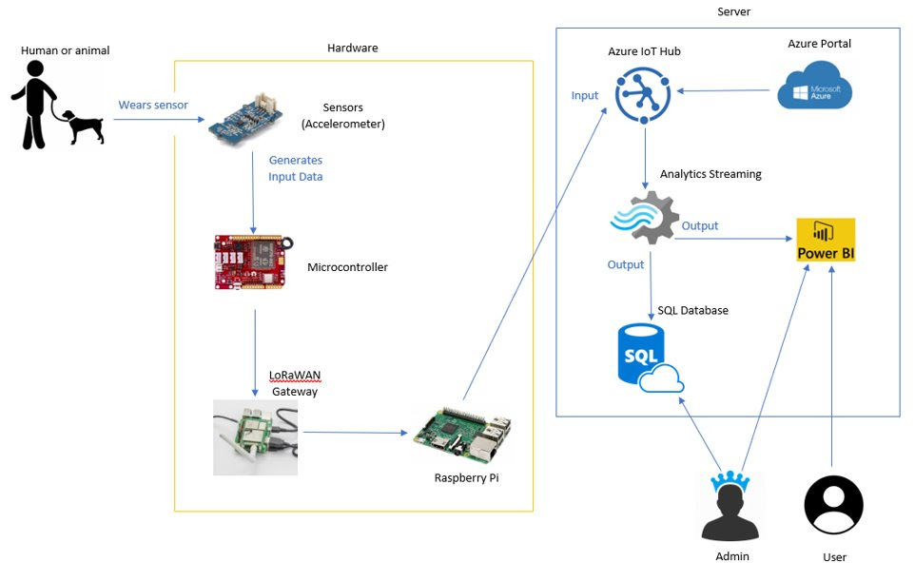
Architecture Diagram
The diagram shows the flow and transmission of data. The data is generated by a sensor worn by an entity and it is captured when within range of the LoRaWAN network. The Raspberry Pi retrieves and then sends the data to our IoT hub where analytic streaming services allow real-time data to be represented in an SQL database and graphically displayed in Power BI.

Slide 6




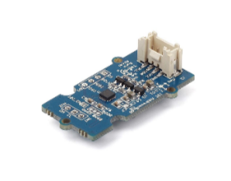



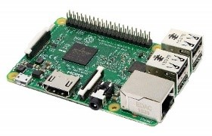

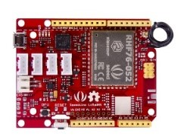
Tech Stack
Collaboration
IoT Integration
Data Processing
Storage & Display
Hardware

Slide 7
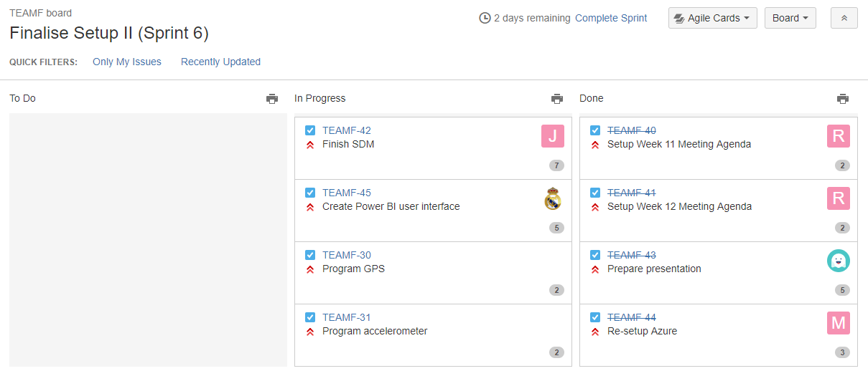
Sprint Planning

Slide 8
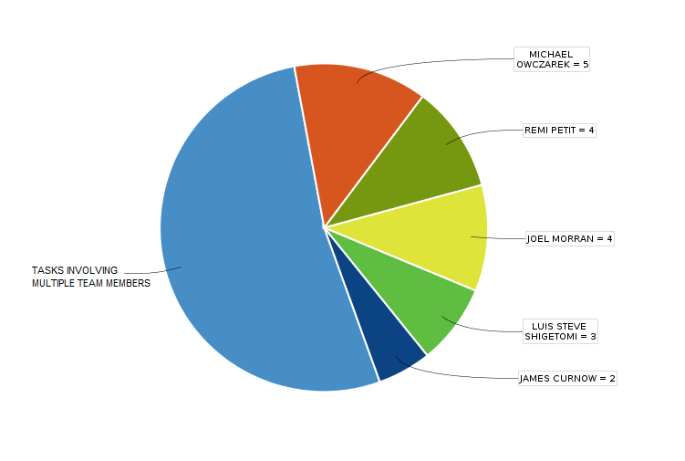
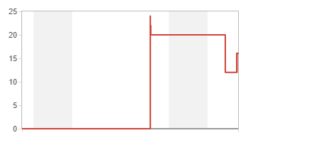
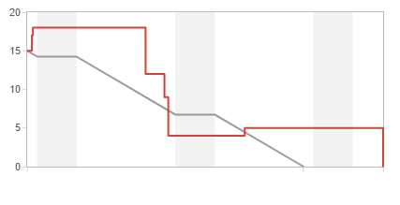
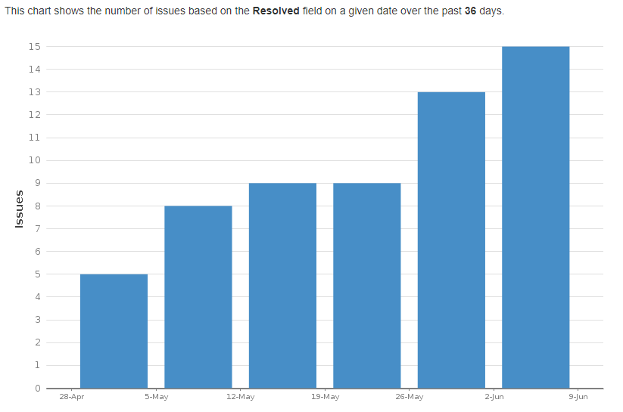
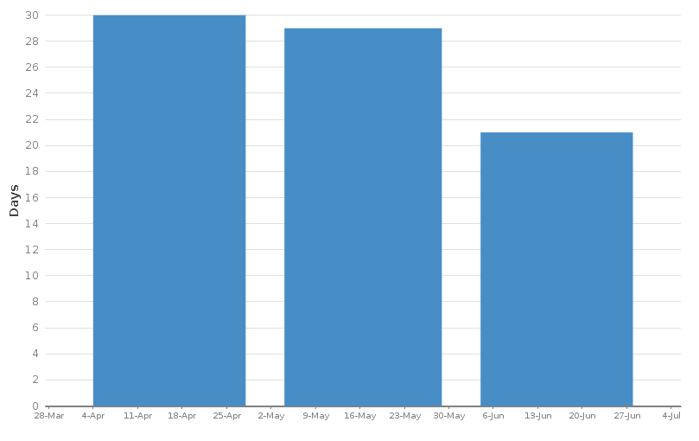
Agile
How we've improved
Plans to improve Agile process further
Earlier Weeks Recent Weeks
This chart shows the average number of days issues were unresolved for on a given day over the past 60 days.

Slide 9

User Stories – As a user I want…
Clean UI / Easy to understand
Easy setup (hardware & software)
Cost effective
Data easy to export

Slide 10
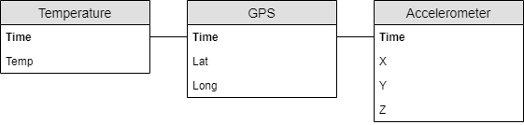
Database

Slide 11
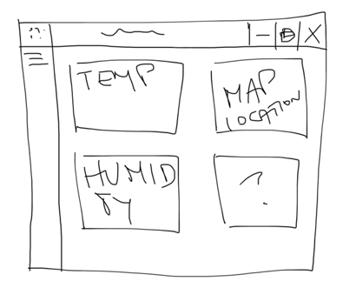
UI WIRE FRAME (Before)

Slide 12
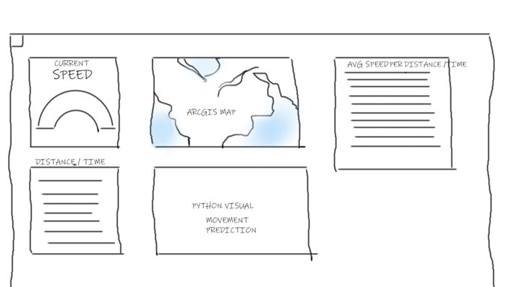
UI WIRE FRAME (After)

Slide 13
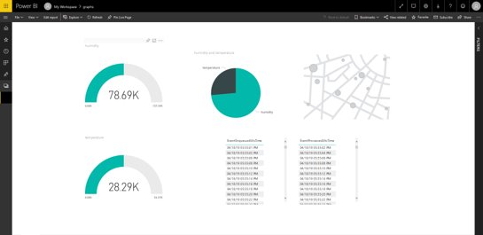
UI Prototype (Before)

Slide 14
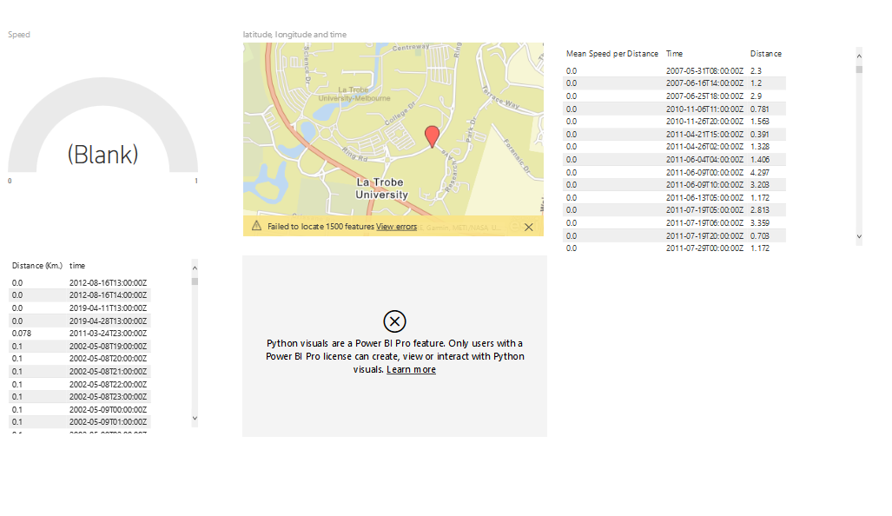
UI Prototype (After)
Desktop Version

Slide 15
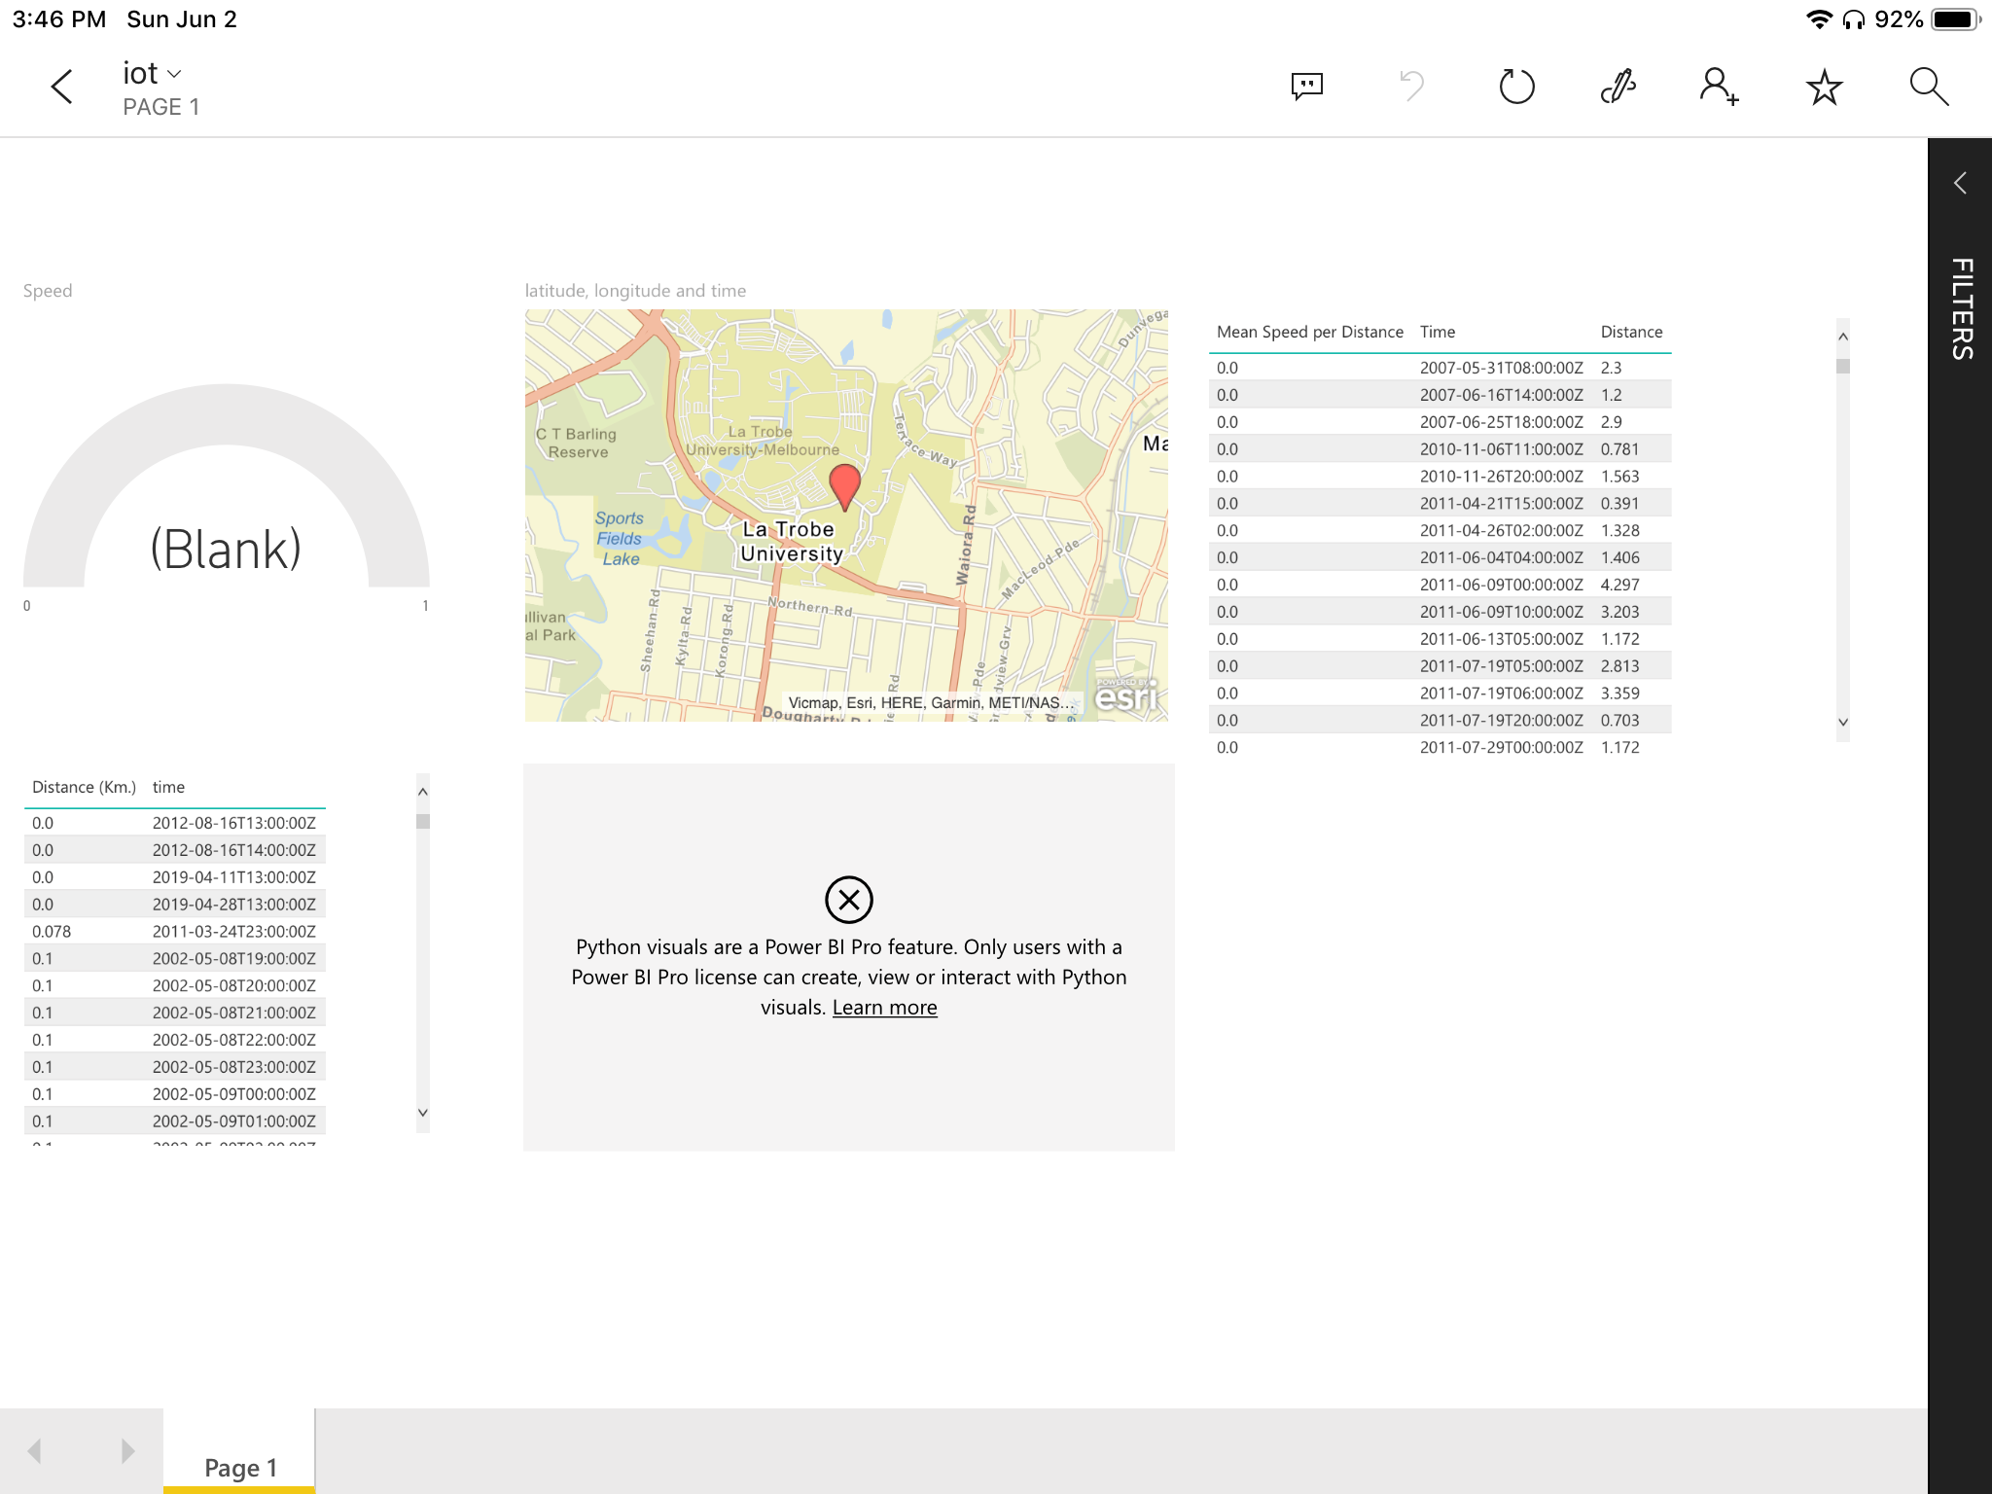
UI Prototype (After)
Ipad Version

Slide 16
Implementation
Show everything running
We have completed hardware set up
Communication between PI, Arduino and cloud achieved

Slide 17
Testing
Tested sending data from Ardunio to LoRaWan to the Cloud
Tested Power BI using our own generated Sample data
Tested UI on small group of users

Slide 18
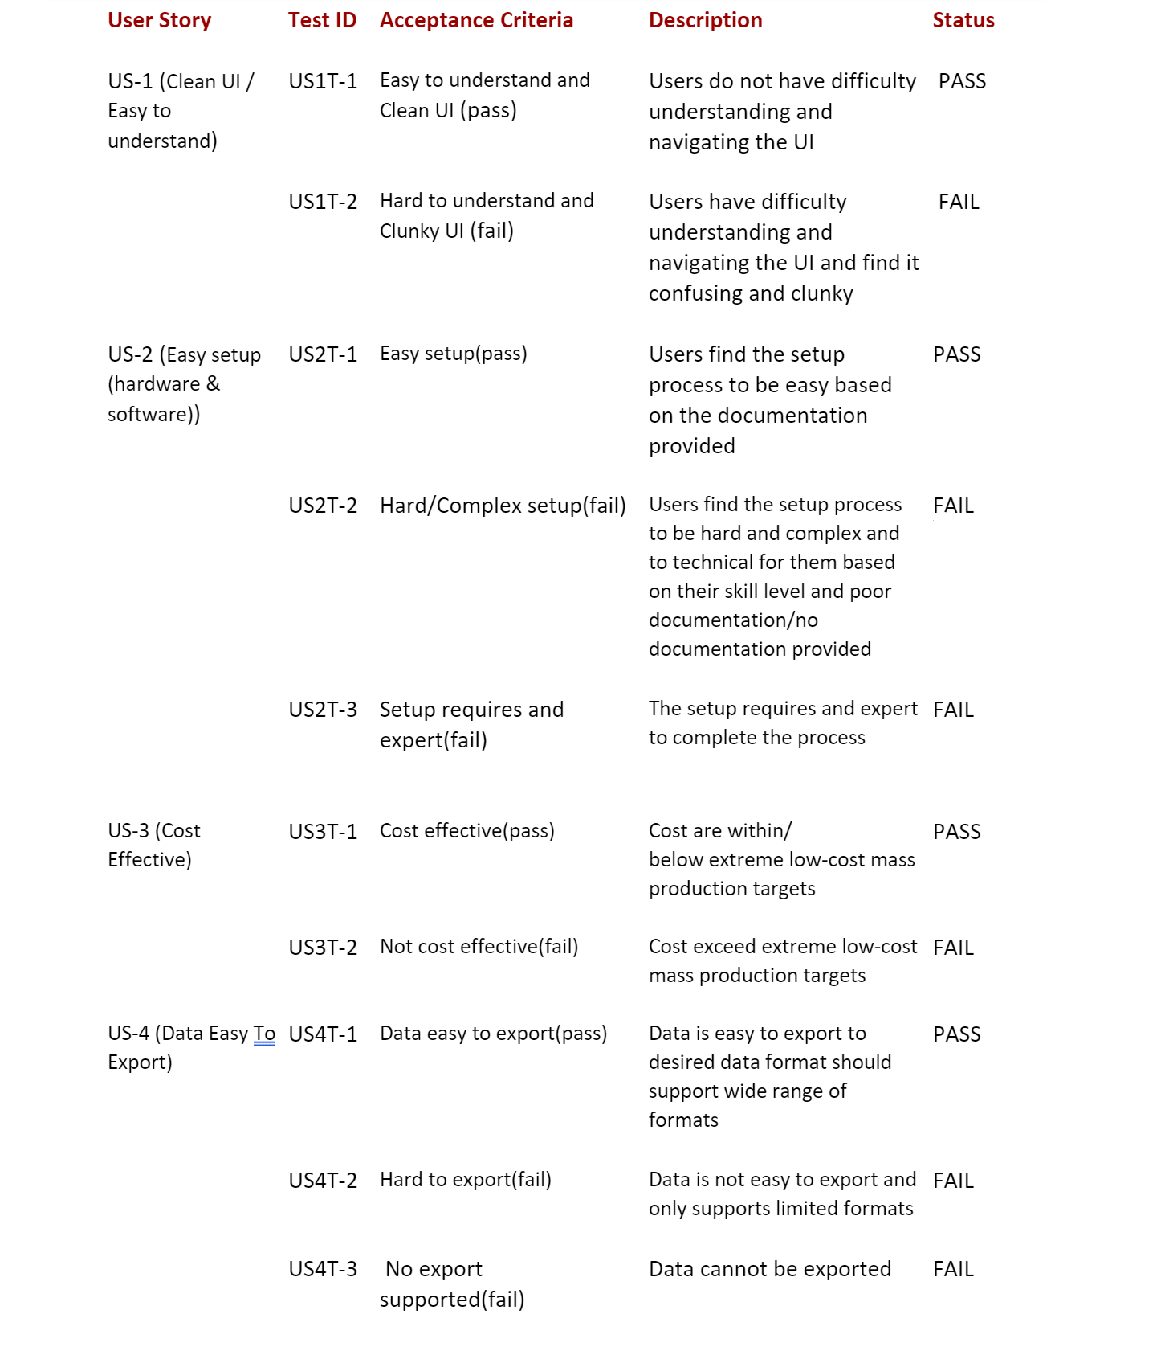

Slide 19
UI Test

Slide 20
Conclusion

